Slide 1
Spatial models: advection, rection, diffusion
Group: Amalia Bogri, Christian Berrig & Jonas Bolduan

Slide 2
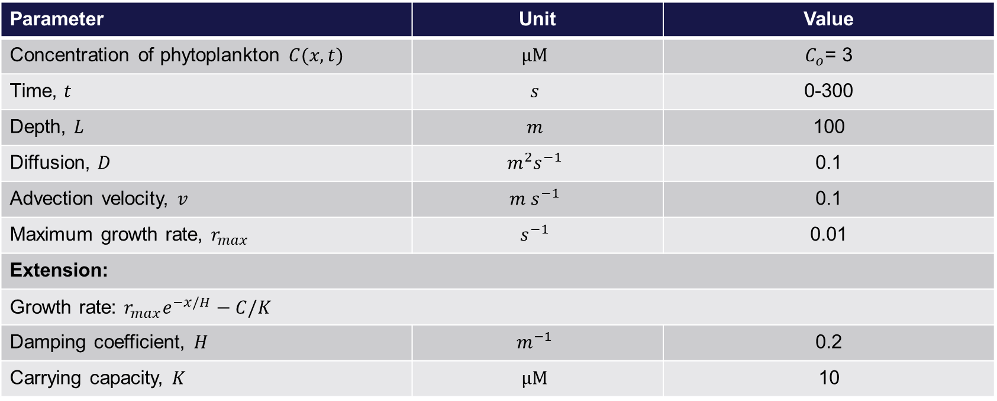
Spatial model: model parameters
Parameter | Unit | Value
Concentration of phytoplankton $C(x, t)$ | $$μM$$ | $C_{o}$= 3
Time, $t$ | $$s$$ | 0-300
Depth, $L$ | $$m$$ | 100
Diffusion, $D$ | $${m^{2}s}^{−1}$$ | 0.1
Advection velocity, $v$ | $${m s}^{−1}$$ | 0.1
Maximum growth rate, $r_{max}$ | $$s^{−1}$$ | 0.01
Extension:
Growth rate: $r_{max}e^{−x/H}−C/K$
Damping coefficient, $H$ | $$m^{−1}$$ | 0.2
Carrying capacity, $K$ | $$μM$$ | 10

Slide 3
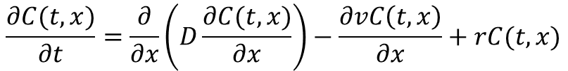
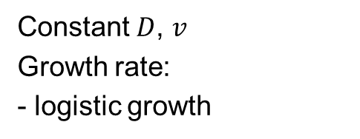
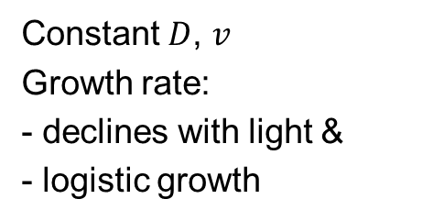

Equations:
General:
$$\frac{∂C(t,x)}{∂t}=\frac{∂}{∂x}\left(D(t,x)\frac{∂C(t,x)}{∂x}\right)−\frac{∂v\left(t,x\right)C\left(t,x\right)}{∂x}+r\left(t,x\right)C(t,x)$$
$$\frac{∂C(t,x)}{∂t}=\frac{∂}{∂x}\left(D\frac{∂C(t,x)}{∂x}\right)−\frac{∂vC\left(t,x\right)}{∂x}+rC(t,x)$$
1
Constant $D$, $v$, $r$:
2
Constant $D$, $v$
Growth rate:
- logistic growth
$$\frac{∂C(t,x)}{∂t}=\frac{∂}{∂x}\left(D\frac{∂C(t,x)}{∂x}\right)−\frac{∂vC\left(t,x\right)}{∂x}+r_{max}\left(1 −\frac{C}{K}\right)C(t,x)$$
3
Constant $D$, $v$
Growth rate:
- declines with light &
- logistic growth
$$\frac{∂C(t,x)}{∂t}=\frac{∂}{∂x}\left(D\frac{∂C(t,x)}{∂x}\right)−\frac{∂vC\left(t,x\right)}{∂x}+r_{max}\left(e^{−\frac{x}{H}} −\frac{C}{K}\right)C(t,x)$$

Slide 4
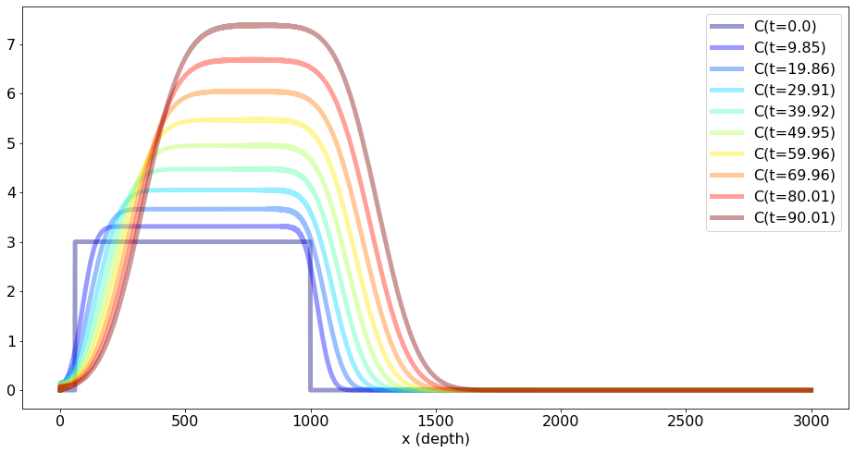
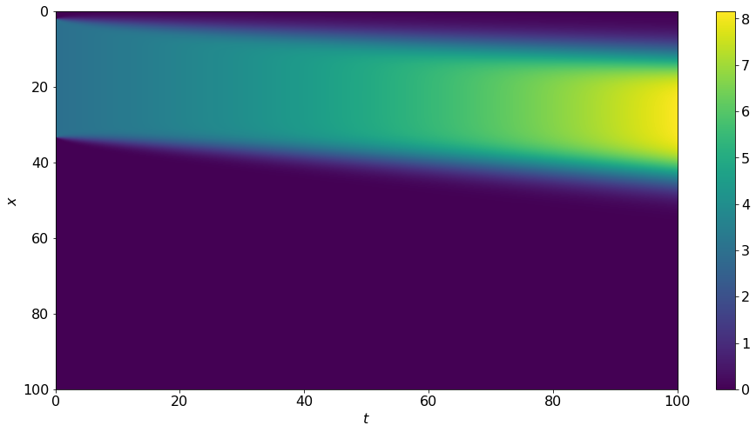

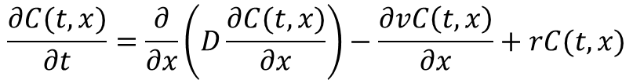
Case 1:
Constant $D$, $v$, $r$
$$\frac{∂C(t,x)}{∂t}=\frac{∂}{∂x}\left(D\frac{∂C(t,x)}{∂x}\right)−\frac{∂vC\left(t,x\right)}{∂x}+rC(t,x)$$
Concentration, μM
Moves deeper with
higher concentrations
Depth, m
Because of the constant diffusion, the graph becomes more ‘blurry’ as time passes.
Because of the constant advection towards a deeper depth, the concentration of phytoplankton moves downwards in time.
Because of the exponential growth, the concentration of phytoplankton increases in time (more yellow).
Depth, m
Concentration, μM
Time, s

Slide 5
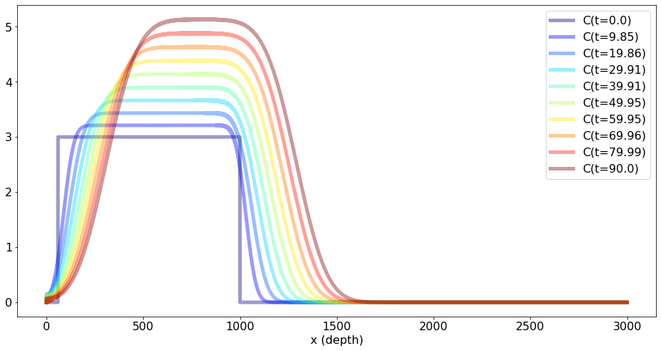
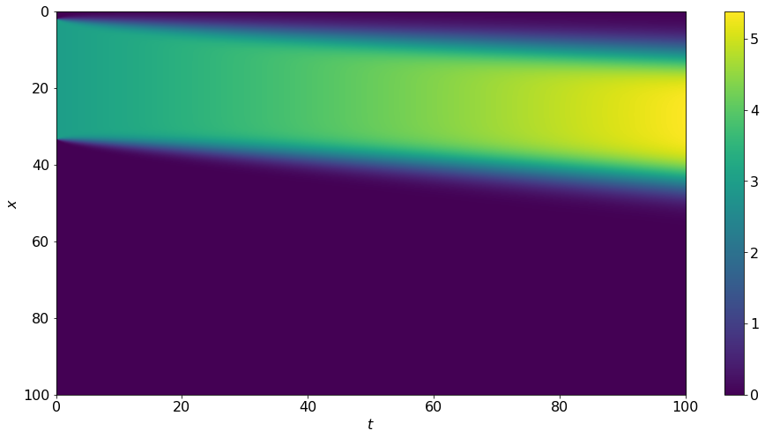

Case 2:
Constant $D$, $v$,
Growth rate depends on C
Concentration, μM
$$\frac{∂C(t,x)}{∂t}=\frac{∂}{∂x}\left(D\frac{∂C(t,x)}{∂x}\right)−\frac{∂vC\left(t,x\right)}{∂x}+r_{max}\left(1 −\frac{C}{K}\right)C(t,x)$$
Moves deeper with
higher concentrations
Depth, m
Because of the constant diffusion, the graph becomes more ‘blurry’ as time passes.
Because of the constant advection towards a deeper depth, the concentration of phytoplankton moves downwards in time.
Because of the logistic growth,
the concentration of phytoplankton increases in time, yet it is limited by the carrying capacity.
Depth, m
Concentration, μM
Time, s

Slide 6
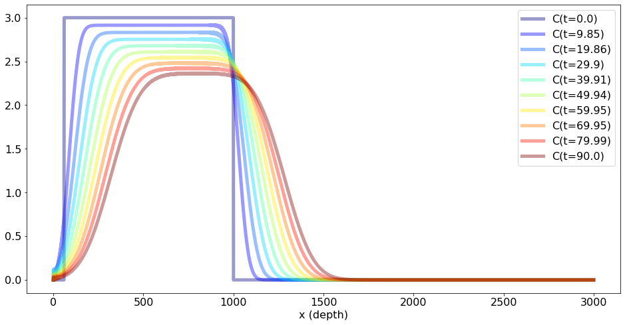
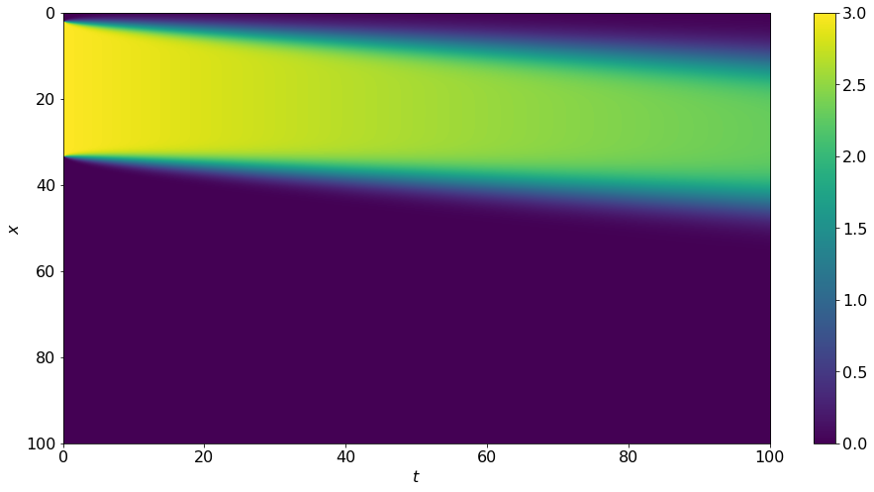

Case 3:
Constant $D$, $v$,
Growth rate declines with light & logistic growth
Concentration, μM
$$\frac{∂C(t,x)}{∂t}=\frac{∂}{∂x}\left(D\frac{∂C(t,x)}{∂x}\right)−\frac{∂vC\left(t,x\right)}{∂x}+r_{max}\left(e^{−\frac{x}{H}} −\frac{C}{K}\right)C(t,x)$$
Moves deeper with
lower concentrations
Depth, m
Because of the constant diffusion, the graph becomes more ‘blurry’ as time passes.
Because of the constant advection towards a deeper depth, the concentration of phytoplankton moves downwards in time.
Because of the growth rate that is exponentially decaying with depth
& is depended on C,
the concentration of phytoplankton decreases the more it sinks by advection, in time.
Depth, m
Concentration, μM
Time, s

Slide 7
Python code
# Flux:
J = lambda c, x, t, delta: c*v(x, t) - D(x, t)*ddx(c, delta)
# Intrinsic growth
f = lambda c, x, t: r(x, t)*c*(np.exp(- x/H) - c/K) # case 1
# Case 2: f = lambda c, x, t: r(x, t)*c*(1 - c/K)
# Case 3: f = lambda c, x, t: r(x, t)*c*(np.exp(- x/H) - c/K)
def DAR(t, state, *params):
for key, val in params:
assign_str = f"{key} = {val}"
exec(assign_str)
deltax = L/N
x_list = np.arange(0, L, deltax)
C = state
dCdt = -ddx(J(C, x_list, t, deltax), deltax) + f(C, x_list, t)
return np.array(dCdt)
C_init = np.zeros(N)
C_init[int(N*1/50):int(N*2/6)] = 3
params = tuple(params_dict.items())
num_sol = solve_ivp(DAR, (0, 100), C_init, args=params)
ns = num_sol.y
t_list = num_sol.t
fig, ax = plt.subplots(figsize=(16,8))
im = ax.imshow(ns, aspect="auto", extent=[t_list[0], t_list[-1], L, 0])
ax.set_xlabel("$t$")
ax.set_ylabel("$x$")
fig.colorbar(im,)
filename = "DAR_heatmap"
plt.show()
print(params_dict.items())
fig, ax = plt.subplots(figsize=(16,8))
num_levels = 10
levels = [int(k*len(ns.T)/num_levels) for k in range(num_levels)]
colors = plt.cm.jet(np.linspace(0,1,num_levels))
for i, l in enumerate(levels):
ax.plot(ns.T[l], color=colors[i], alpha=0.4, label=f"C(t={round(t_list[l],2)})")
ax.set_xlabel("x (depth)")
ax.legend(loc="upper right")
filename = "DAR_profile"
plt.show()
# Import stuff:
from scipy.integrate import odeint, solve_ivp
import matplotlib.pyplot as plt
import numpy as np
# This is for reasonable fontsize universally defined:
fs_label = 16
parameters = {
'figure.titlesize': fs_label+6,
'axes.labelsize': fs_label,
'axes.titlesize': fs_label+4,
'xtick.labelsize': fs_label,
'ytick.labelsize': fs_label,
'legend.fontsize': fs_label,
'lines.linewidth': 5
}
plt.rcParams.update(parameters)
# Parameters:
params_dict = dict(
L = 100, #100
N = 3000,
D_const = 0.1, #0.0001
v_const = 0.1 , #0.0001
r_const = 0.01, ##0.0001
H = 0.2, #2
K = 10 #10
)
for k, v in params_dict.items():
assign_str = f"{k} = {v}"
exec(assign_str)
print(assign_str)
ddx = lambda arr, delta: np.array([arr[0]] + list((np.diff(arr[:-1]) + np.diff(arr[1:]))/(2*delta)) + [arr[-1]])
#Simple funtions defining diffusion, advection and reaction
D = lambda x, t: D_const
v = lambda x, t: v_const
r = lambda x, t: r_const
7

